Slide 1
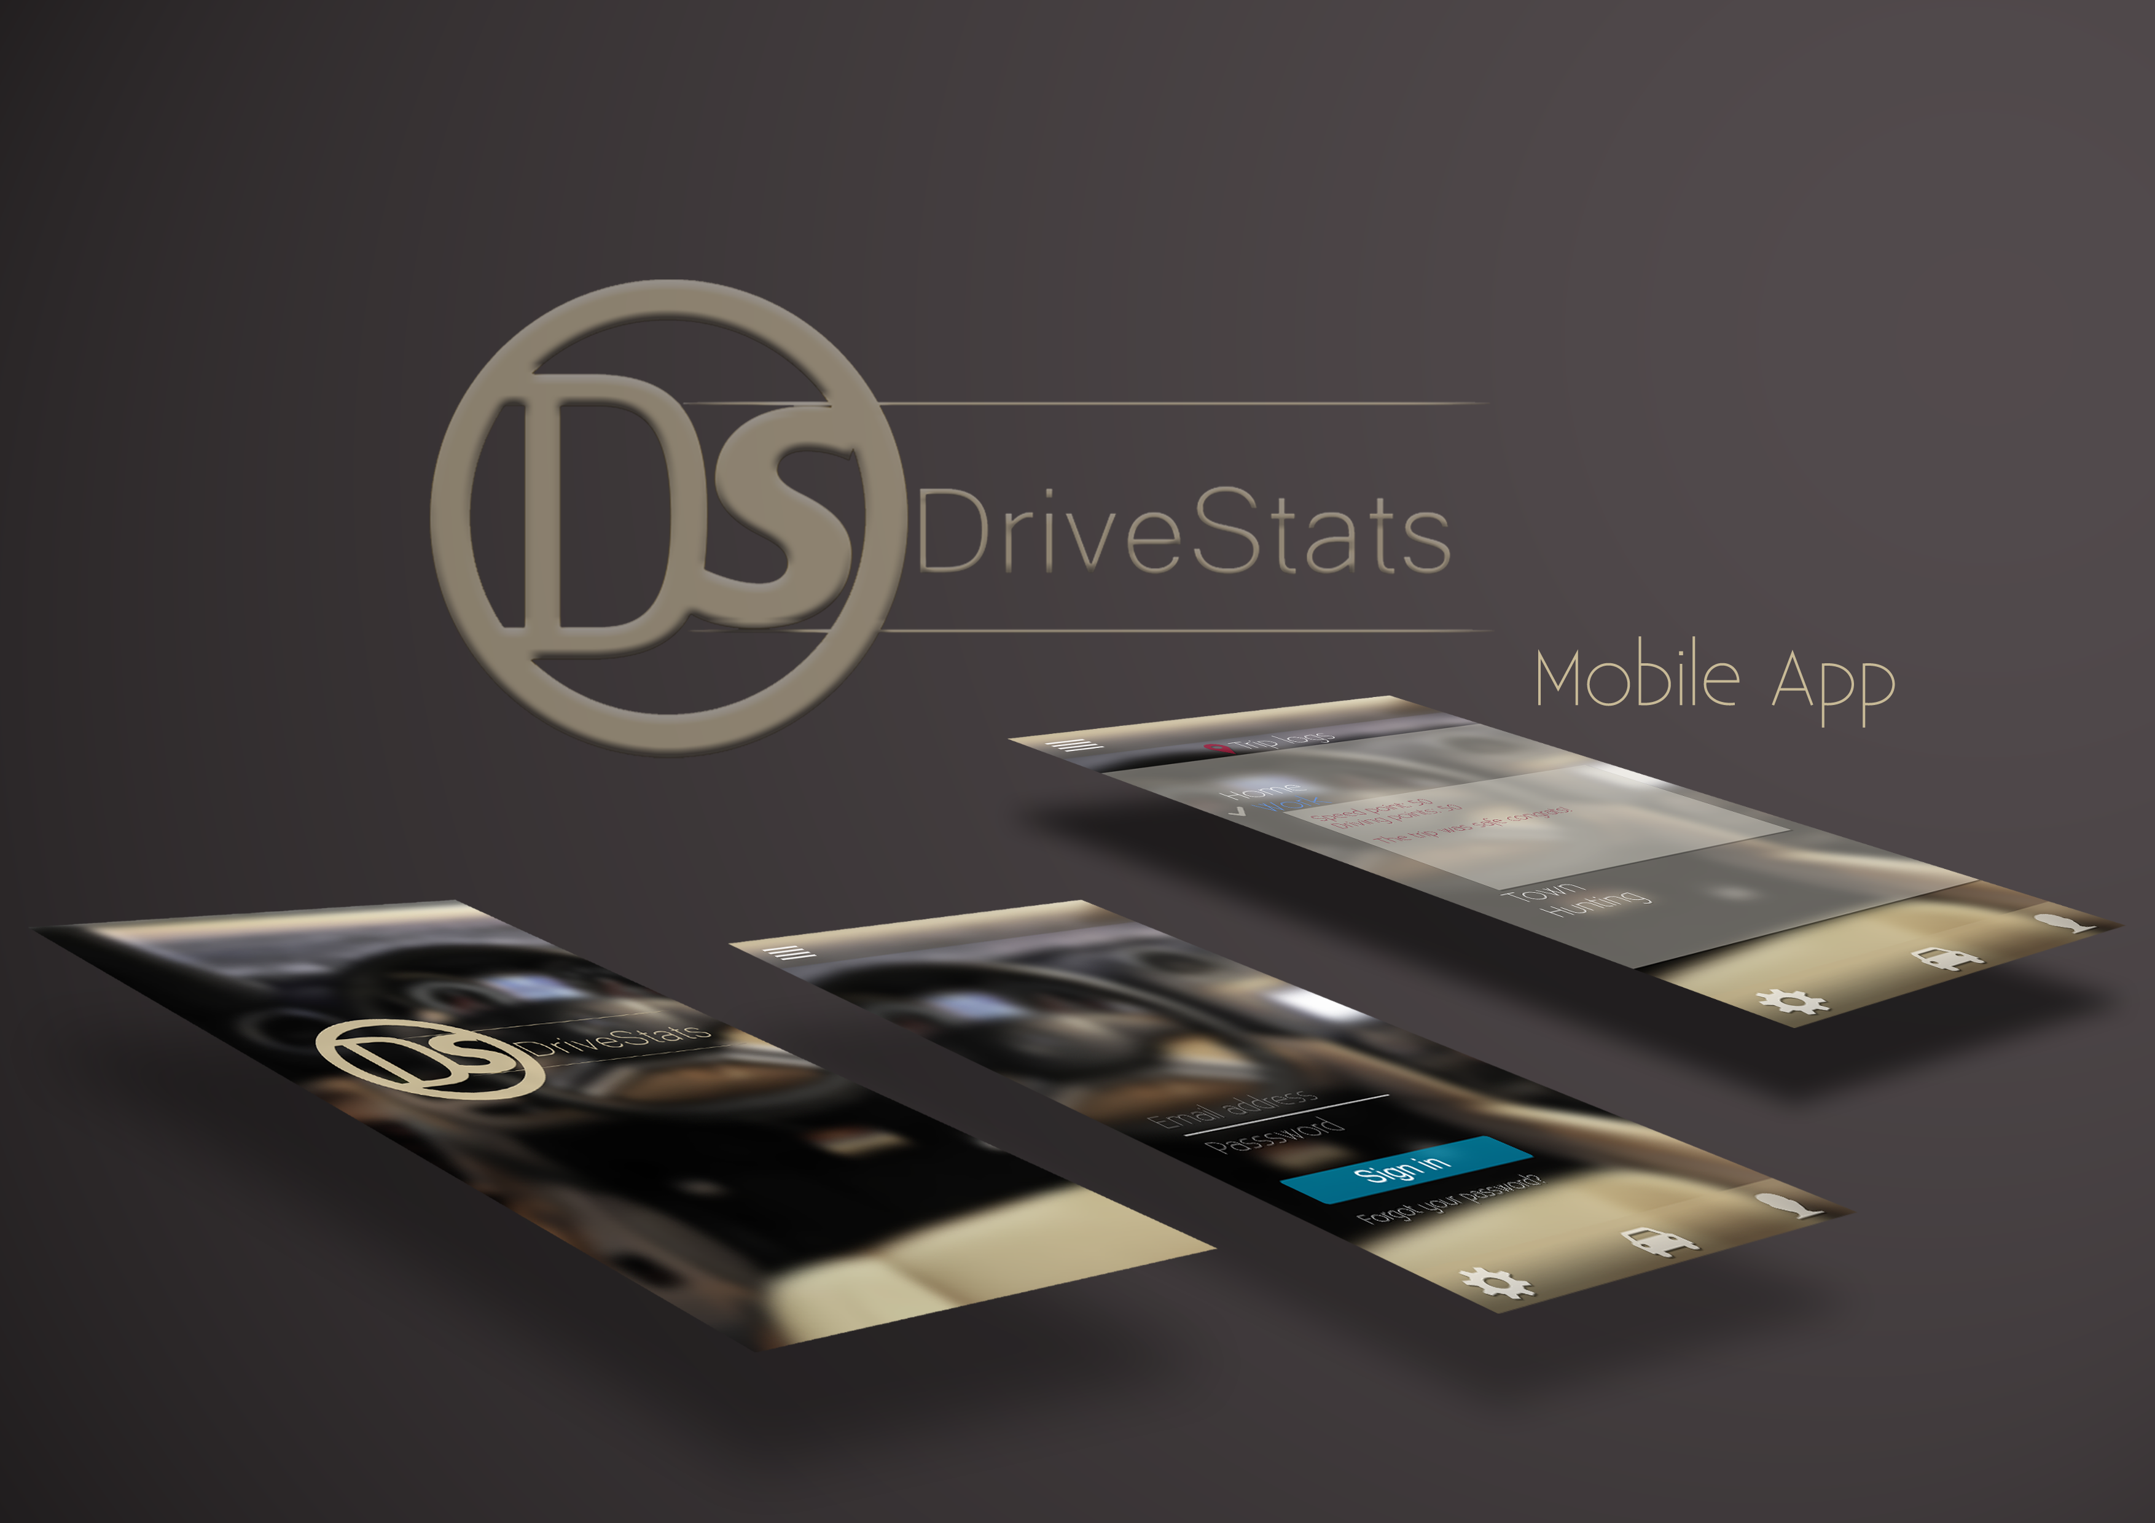
Second Presentation
24-07-2015

Slide 2
A Quick Recap
What We Are Doing
Enthusiastically creating and implementing an application using a C# server and Android Client.
The aim of this project is to produce an app that can record and monitor the driving activity of South African residents and improve driver safety across a range of indicators.
Our project was created to service the Client DVT

Slide 3
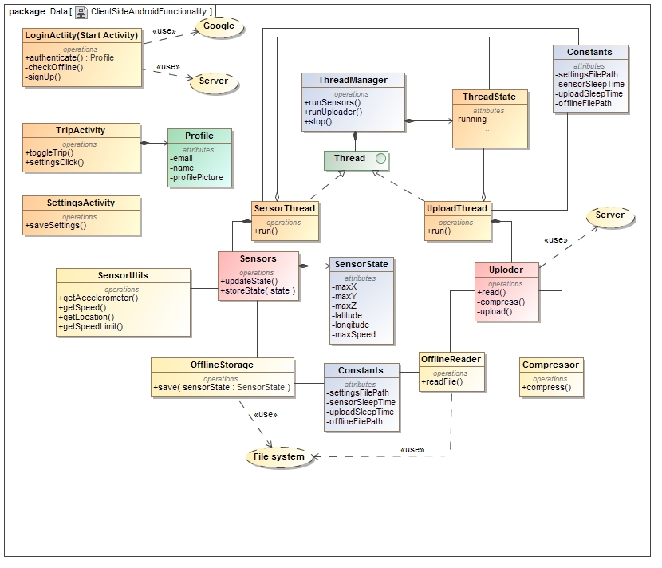
Client Side Class Diagram

Slide 4
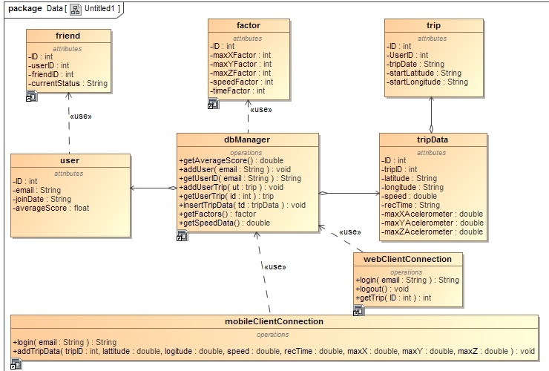
Server Side Class Diagram

Slide 5
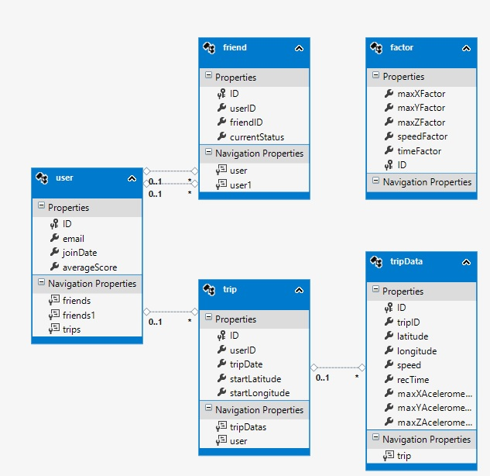
Database Structure

Slide 6
Our Current Capabilities
Android application
Run application in background
Upload and store application data on server
Add users
Database persistence
Mock algorithm data
Server hosting
Calibration

Slide 7
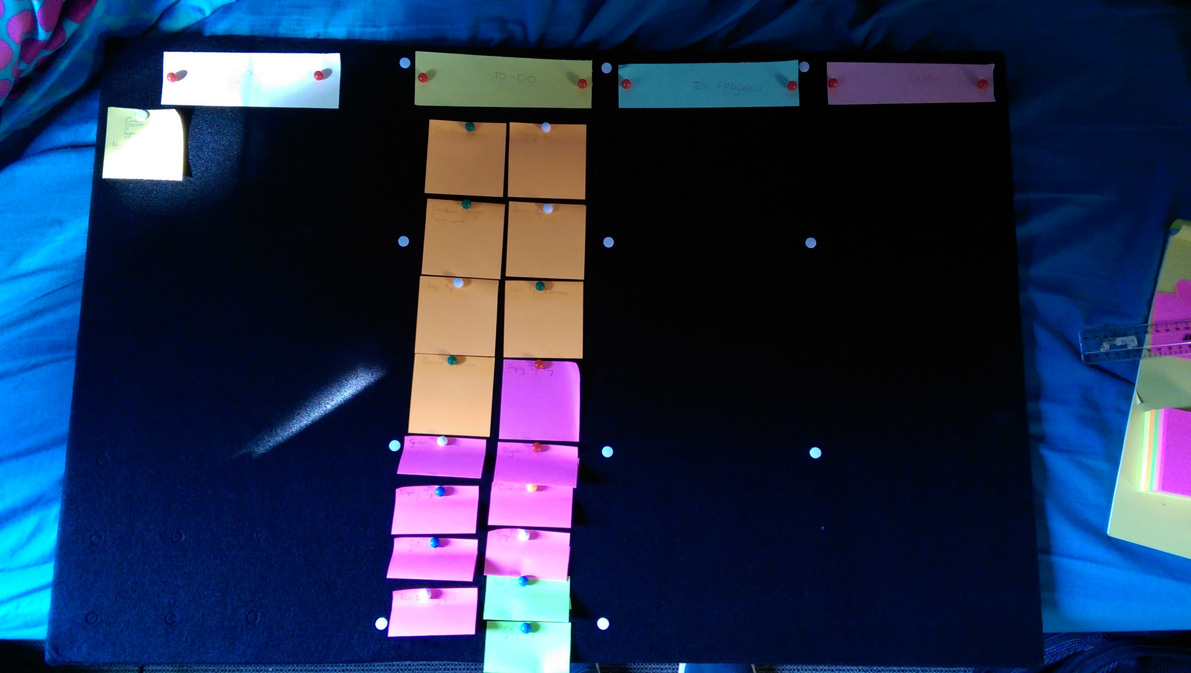
Our Scrum Board

Slide 8
Burn Down Estimates

Slide 9
Achievements Since Last Presentation
Axel Ind: Research pertaining to algorithm development. Technical and documentational support.
Zander Boshoff: Server creation, database creation, database manager creation.
Nick Robinson: Created basic Android application, implemented data capturing, server communication, OR mapping.
Tim Kirker: HTML creation, server communication.
William Seloma: Android creation support (extensive contact and collaboration with Nick)

Slide 10
Challenges We Have Encountered
Google Login
Speed Limit Gathering
Data Compression
Server Hosting
Team Communication
Algorithm Development
PHP Hosting

Slide 11
What’s Left to do?
GUI Optimisation
Algorithm implementation
Manual/ReadMe files
Graph creation & display
Adding friends
Speed limit calculations
Proper exception handling
Extensive user testing

Slide 12
Algorithm Concerns
Speed limits
Normalisation concerns
Required standard deviation
Distribution to use

Slide 13
Our Initial Concepts For UI

Slide 14
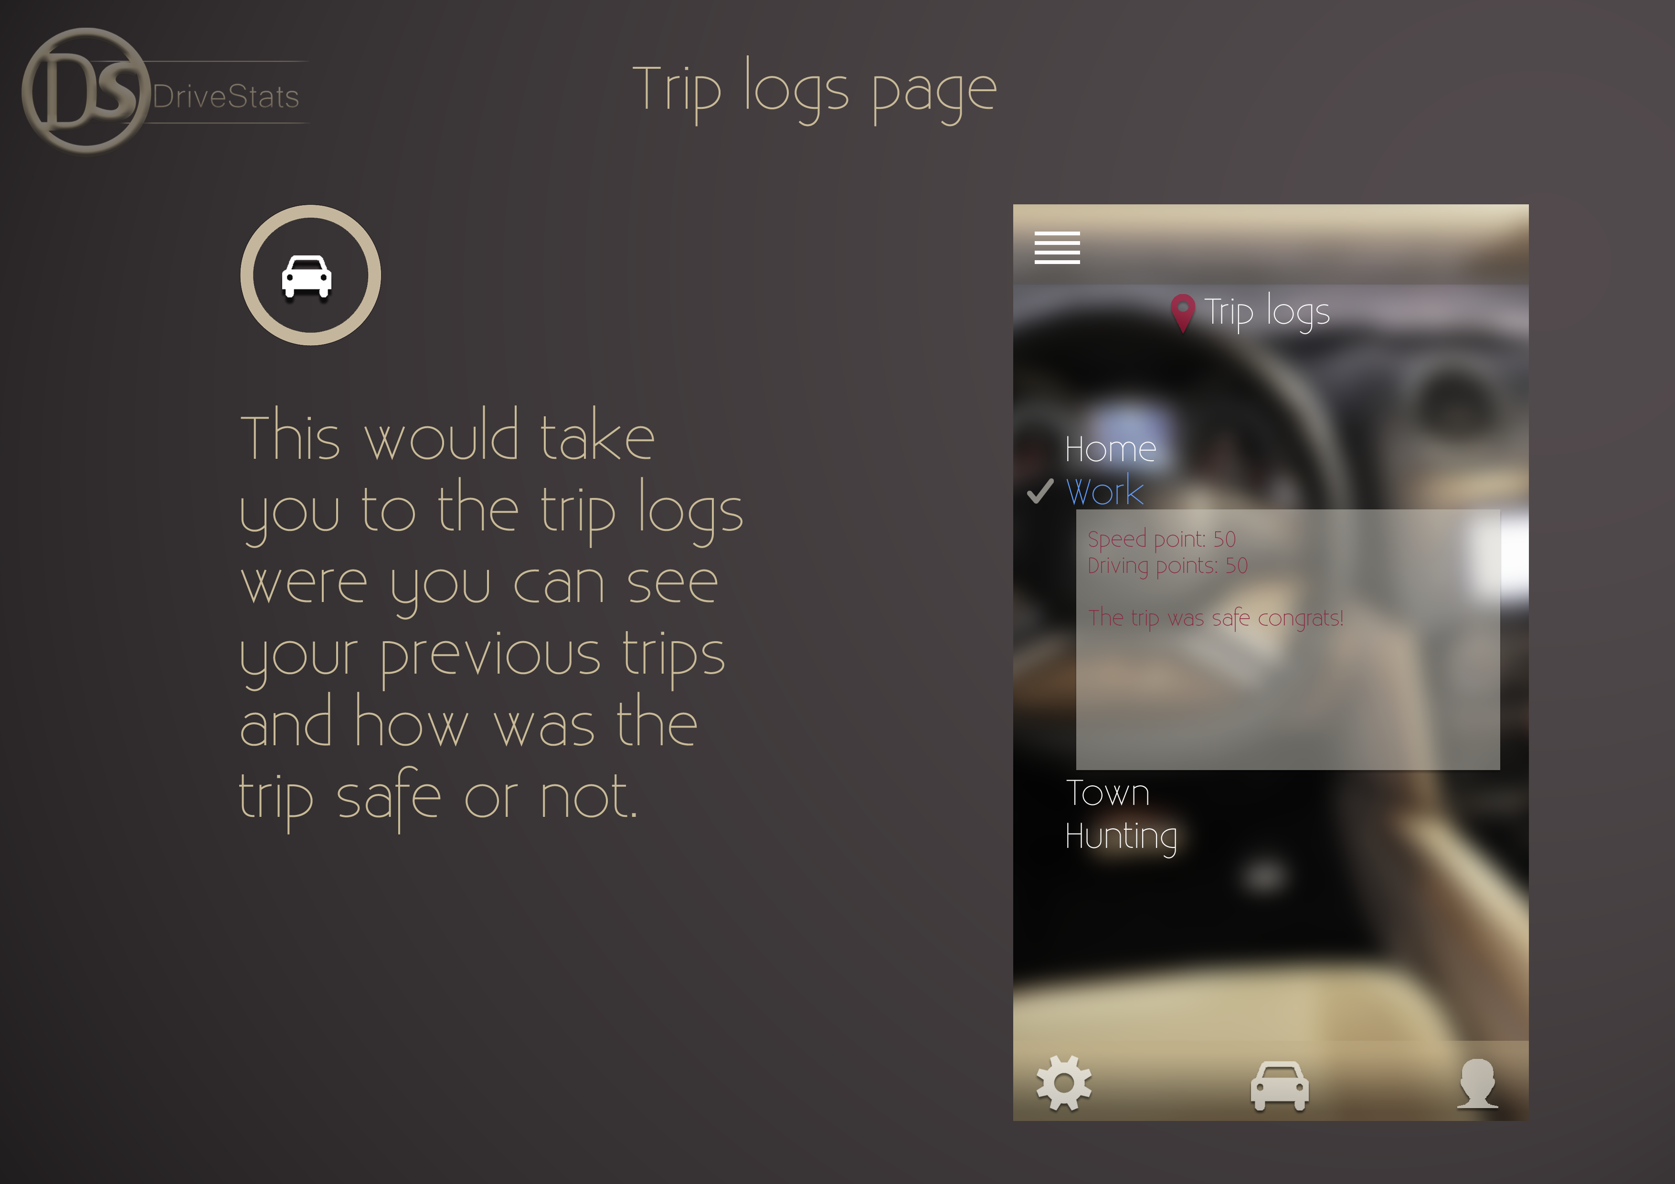

Slide 15
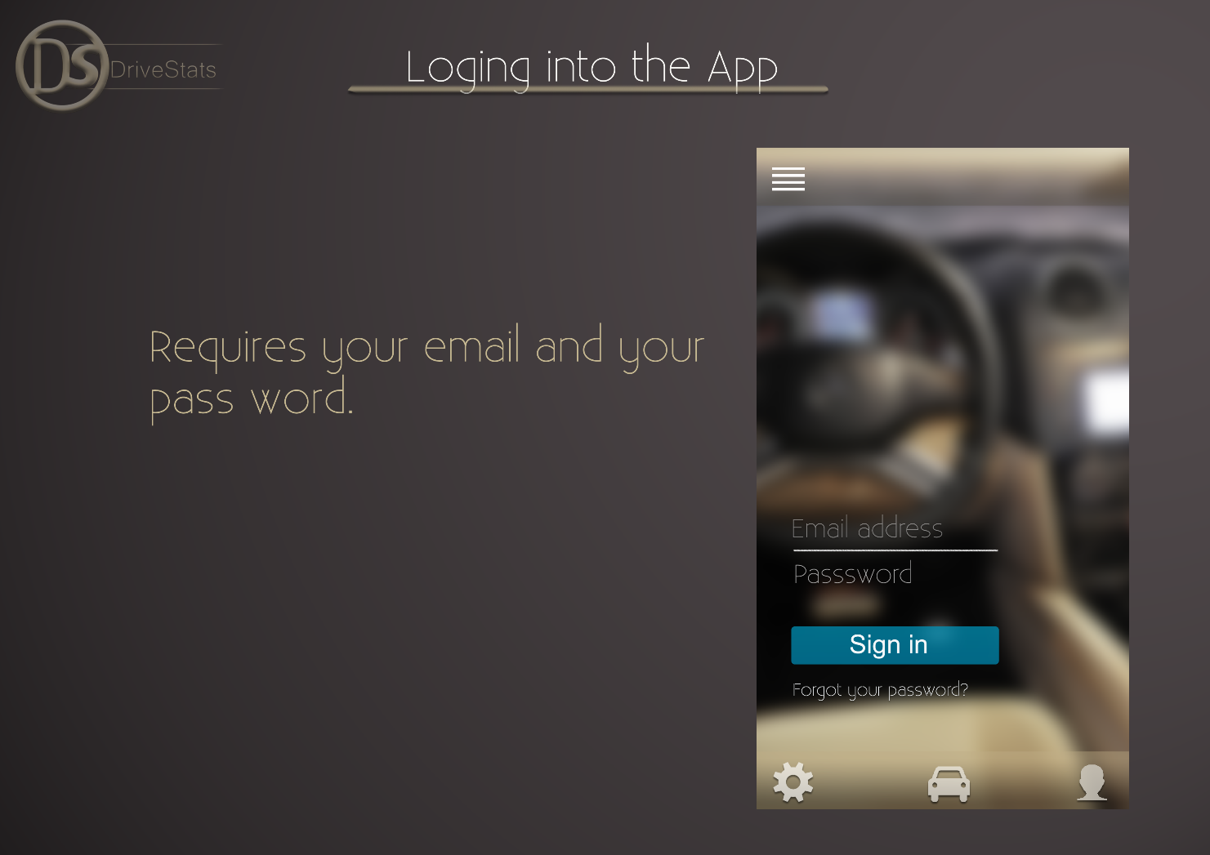

Slide 16
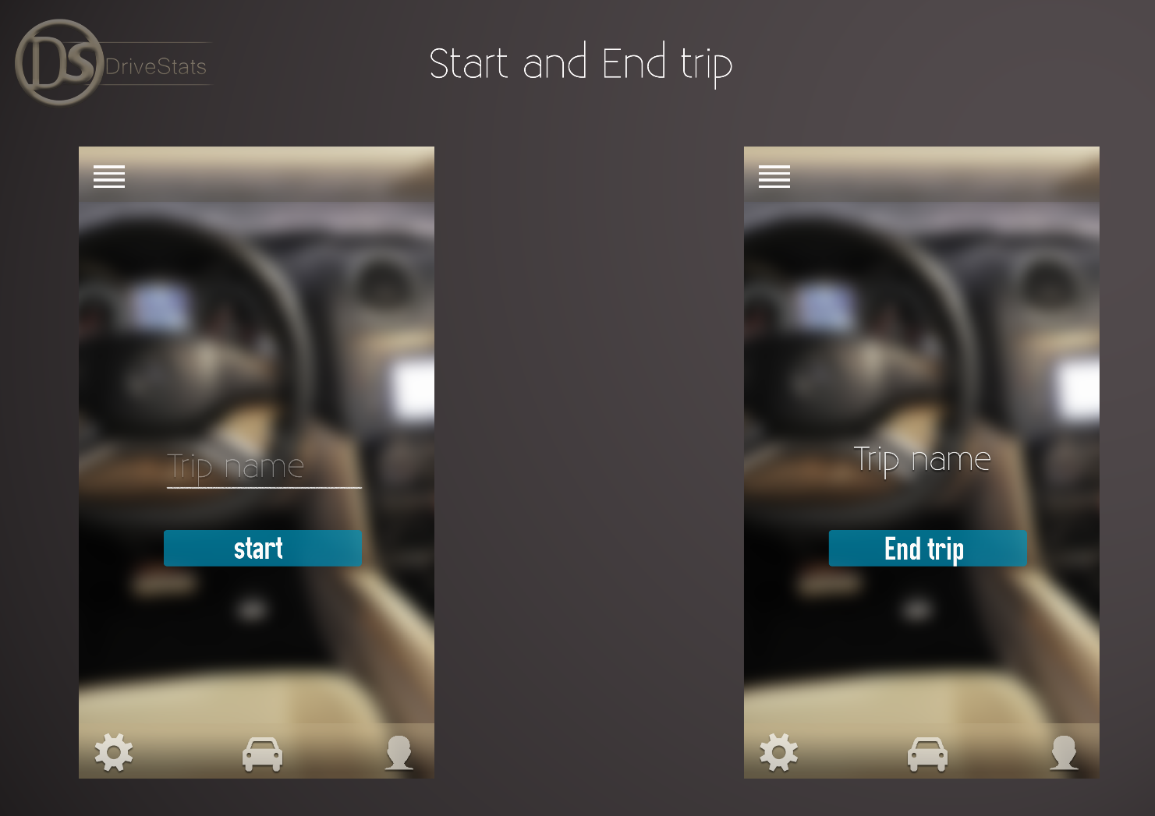

Slide 17
And many more ideas to come…

